Slide 1


BrisPUG

Slide 2




Sponsored By:

Slide 3

WRITE-Information
“About Me”

Slide 4





Former Student
Senior Automation Consultant at Insync Technology
PowerShell (2013)
Play Paintball and Running. Trained in CQB.
PowerShellMichael \ PowerShellLive \ BrisPug
@PowerShellMich1
https://au.linkedin.com/in/michael-zanatta-61670258
https://www.youtube.com/channel/UCQfLvFYohCCm_gTPEUfaAbw
Notes:
Former Student at SBIT (Class of 2008)
Senior Automation Consultant at Insync Technology/ PowerShell SME/ Advocate/ Speaker/ Author & Meetup Organizer
Stream PowerShell Projects. Channels on Twitch.Tv/ Youtube
MSDOS 4.2 (2004), VBSCRIPT (2005), POWERSHELL (2013)
Play Paintball and Running. Trained in CQB
Brisbane PowerShell User Group

Slide 5
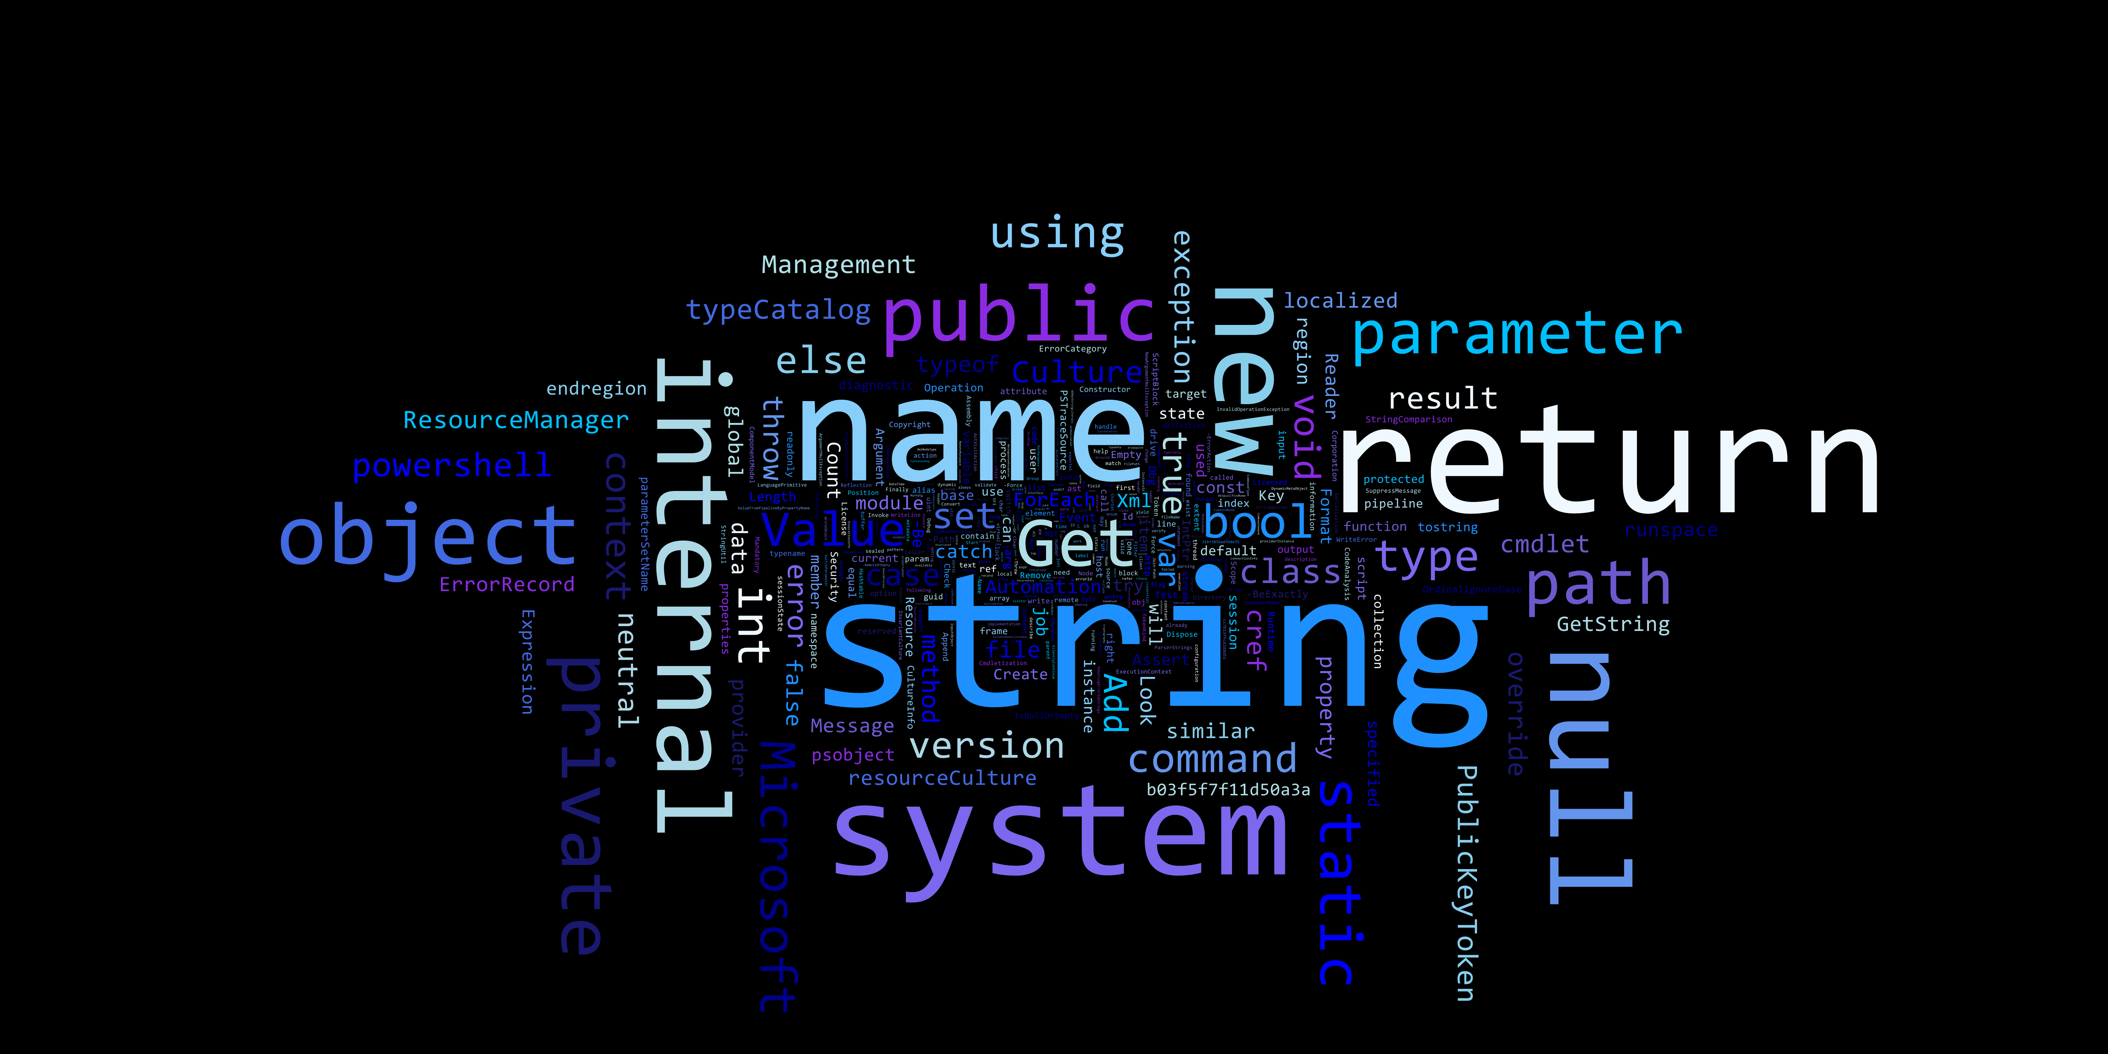

WHAT is PowerShell?
Notes:
So what is PowerShell?
Is it a Scripting Language?

Slide 6
PowerShell is an Automation/ Configuration Framework
PowerShell Scripting Engine
Desired State Configuration (IaC)
Notes:
PowerShell is an Automation Configuration Framework.
PowerShell is built on the .NET framework and C#, which makes it language variant of C#.
However PowerShell offer’s more then just C#. It can run J#, VB.NET & with other modules C++ making it extremely versicle.
I heard one person tell me that PowerShell is the Glue that holds Microsoft Product Together. While not literal, PowerShell plays a key role in Microsoft Technologies
It consists of two main components:
PowerShell Scripting Engine. Object Orientated.
Desired State Configuration. Defines how a software environment should be configured.
No Desired State Configuration in this lesson.
PowerShell Scripting Engine
PowerShell Offers Unit Based Testing
Administrative management of All Windows Applications (Active Directory, Exchange, HyperV, Clustering, System Centre Suite)
It can interact with Web API’s (SOAP and REST)
It can do anything!

Slide 7
WHAT can
PowerShell Do?

Slide 8

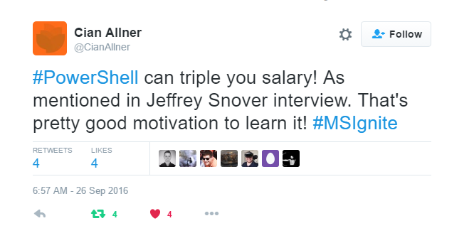
Increase your Salary
Notes:
Josh Duffney wrote an article called: “Doubling My Salary a PowerShell Story”
He talked about the financial benefits of learning PowerShell.
Sources: http://duffney.io/doubling-my-salary-a-powershell-story

Slide 9
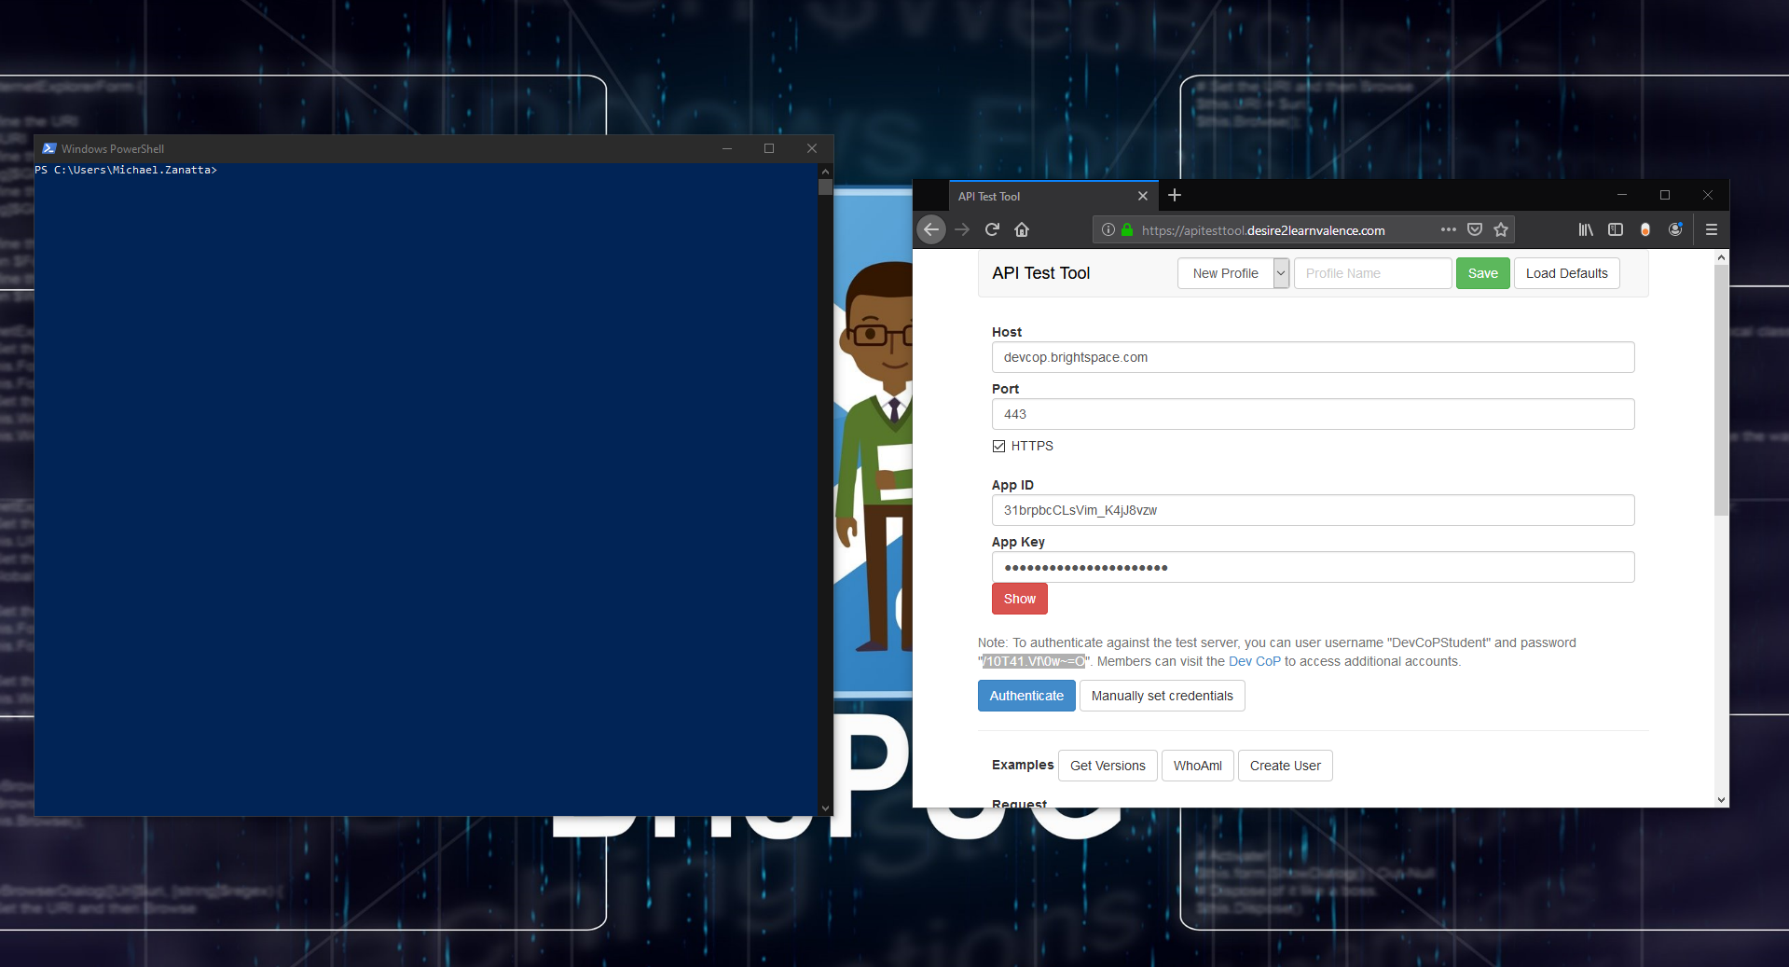
Desire to Learn (D2L) PowerShell Module
Notes:
Demo Video:

Slide 10
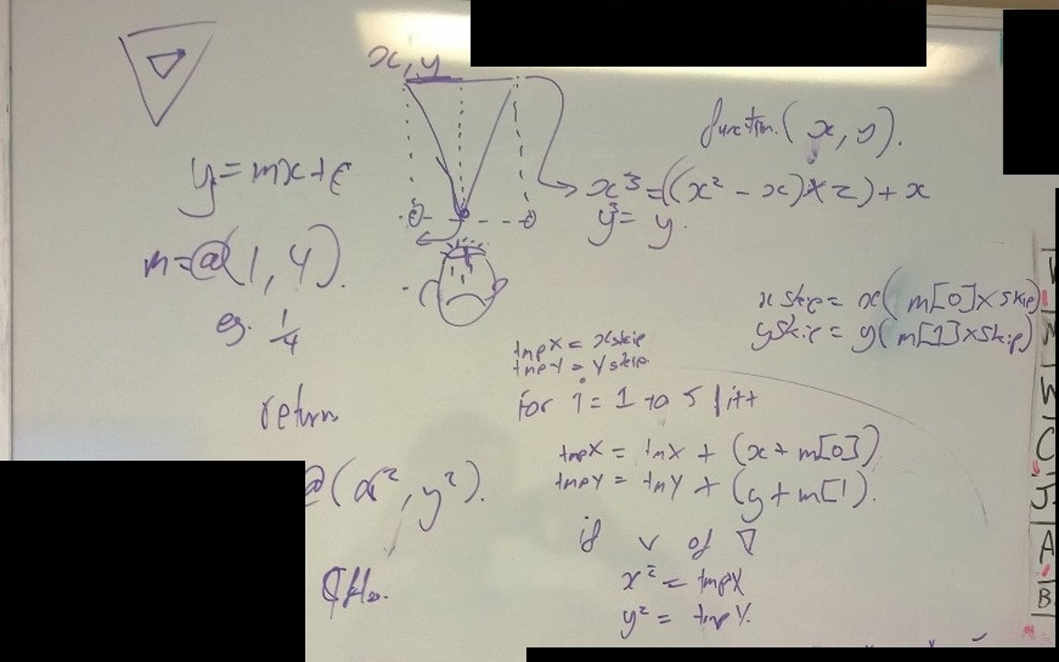
Battlefield 4 Pixel Aimbot

Slide 11
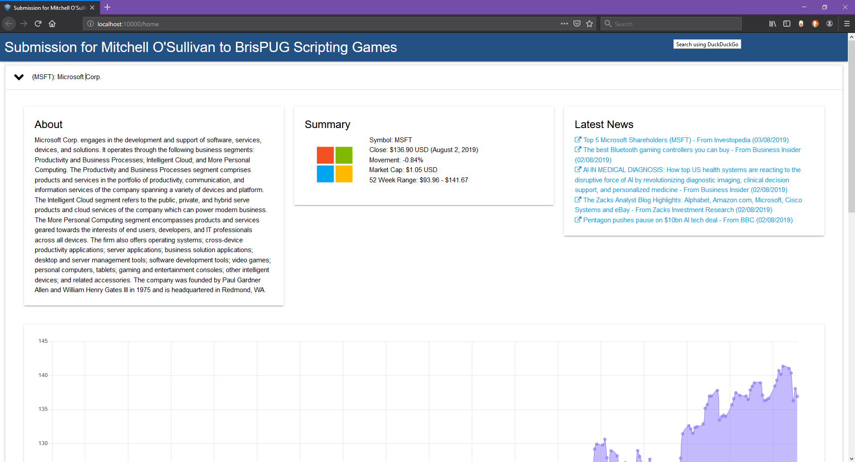
PowerShell Universal Dashboard

Slide 12
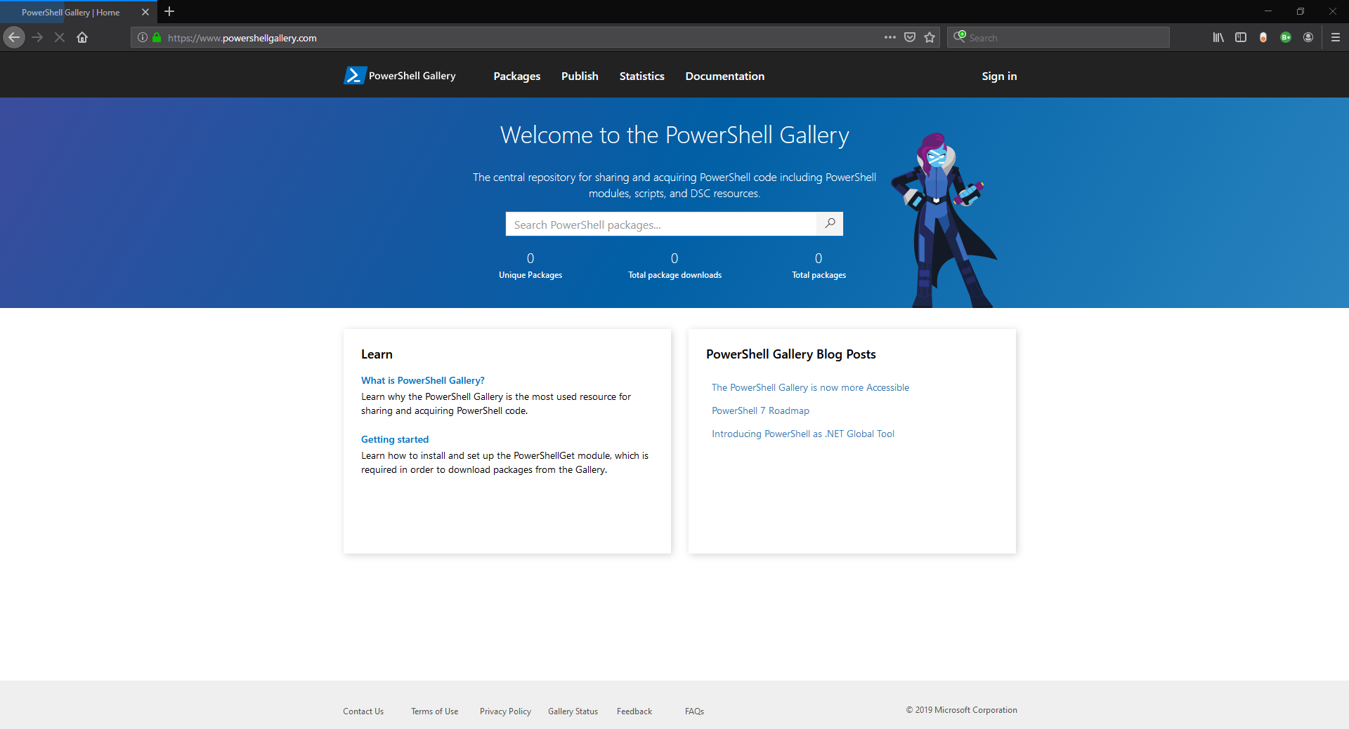
PowerShell Gallery

Slide 13
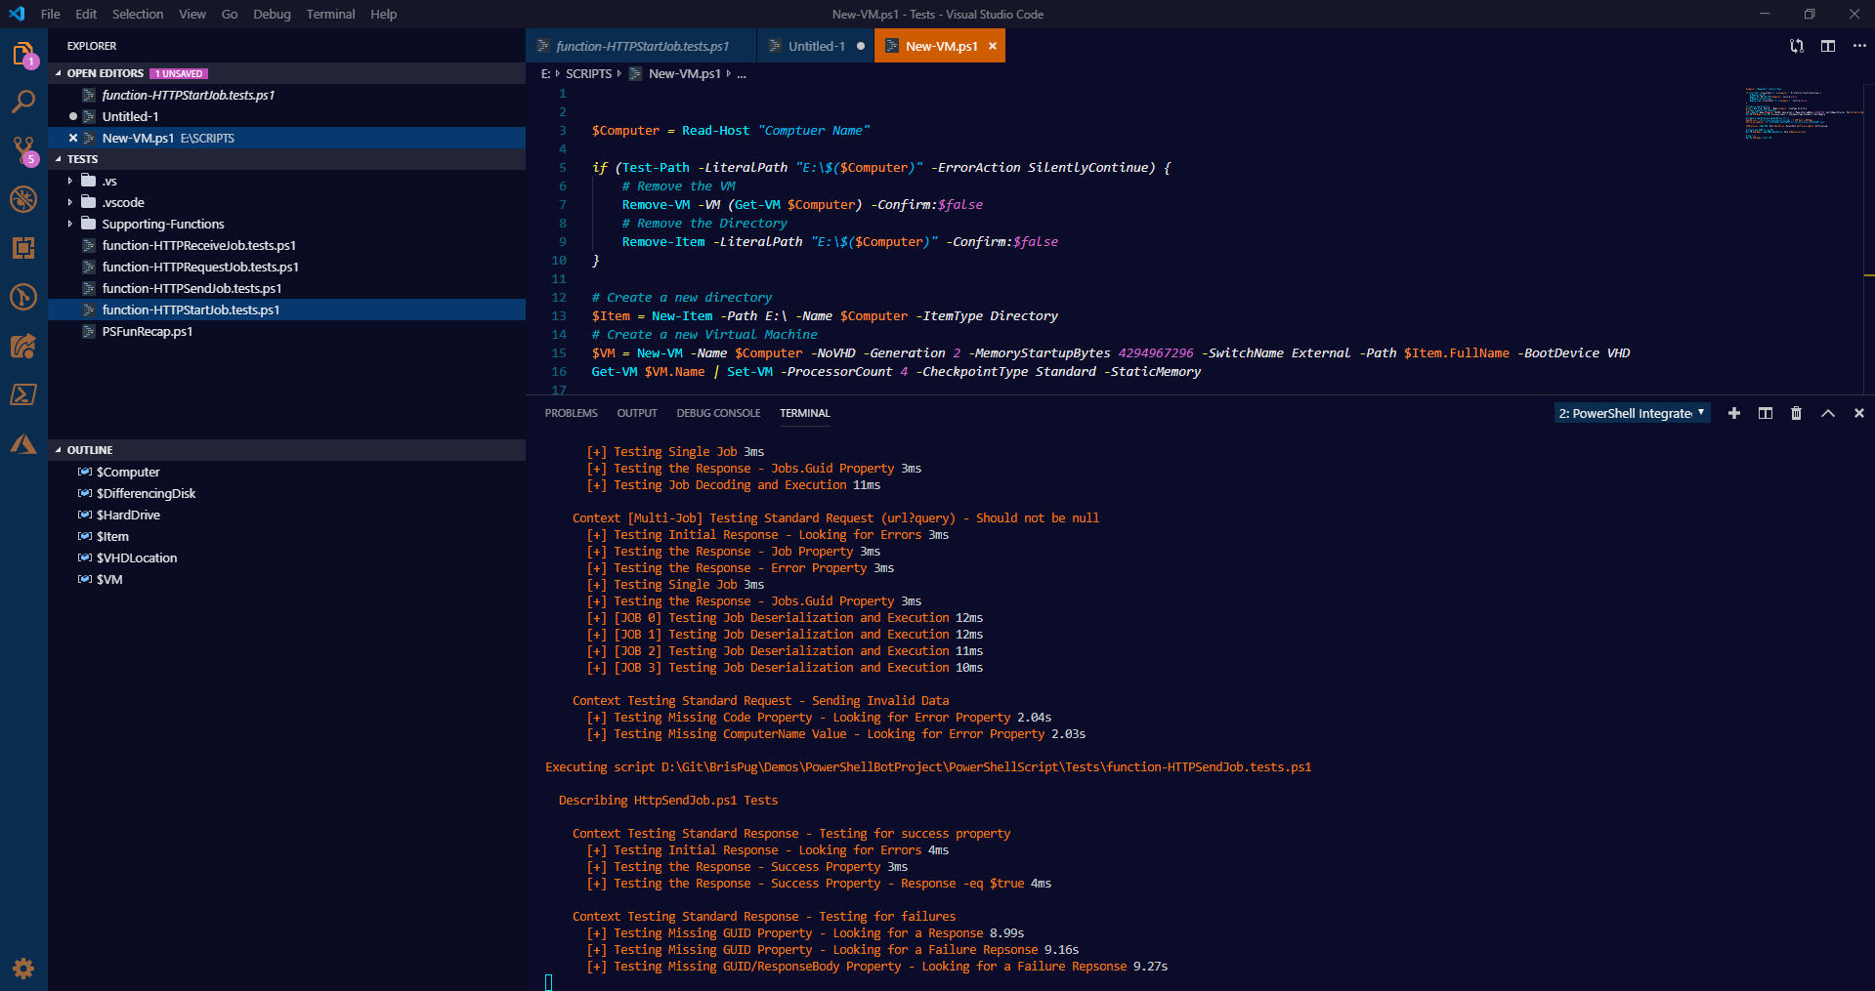
Pester Testing

Slide 14
The PowerShell
“Cmdlet” Explained
Notes:
A PowerShell cmdlet is a lightweight command that is used in the Windows PowerShell environment.
Windows PowerShell uses a verb-and-noun name pair to name cmdlets
They are not stand-alone executables. Cmdlets are instances of objects . i.e Ping, Net, Tracert
Cmdlets can be created from as few as a dozen lines of code.
Cmdlets do not generally do their own parsing, error presentation, or output formatting. Parsing, error presentation, and output formatting are handled by the Windows PowerShell.
Source: https://docs.microsoft.com/en-us/powershell/developer/cmdlet/cmdlet-overview

Slide 15
The Verb-Noun Naming Standard
Was developed to make it easier to understand that intention of the cmdlet
Verb Prefix describes the action
Noun Suffix describes the resource
Nouns are abbreviated if too long
Notes:
Sources: https://docs.microsoft.com/en-us/powershell/developer/cmdlet/cmdlet-overview
Sources: https://docs.microsoft.com/en-us/powershell/developer/cmdlet/approved-verbs-for-windows-powershell-commands

Slide 16
Rename-Computer
Add-WindowsFeature
New-NetIPAddress
Set-DNSClientServerAddress
Restart-Computer
Install-ADDSForest
Set-DNSServerForwarder

Slide 17
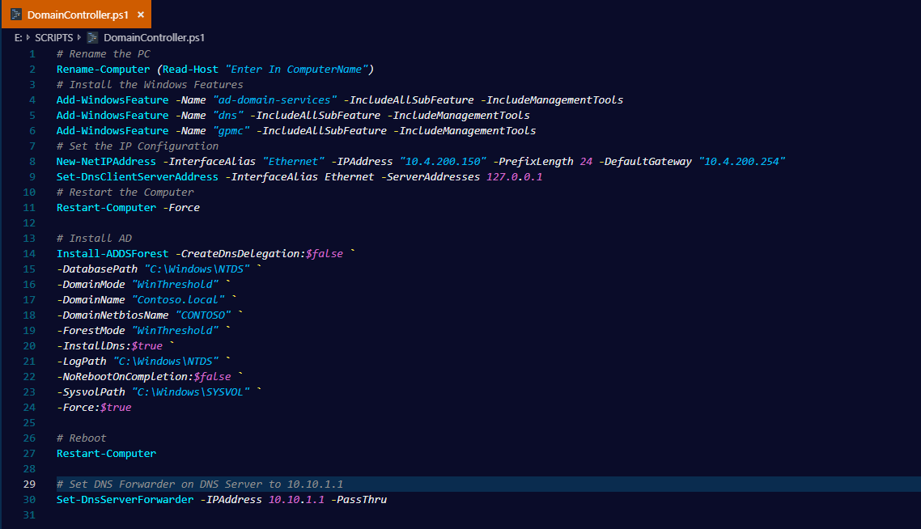

Slide 18
Parameters
Parameters define the input of the Cmdlet. (Pass Arguments to the Script)
Notes:
Parameters define the input of the cmdlet. (Pass Arguments to the Script)
Example:
DVD Player. The parameters are the button on the DVD player.
Sources: https://docs.microsoft.com/en-us/powershell/developer/cmdlet/cmdlet-overview
Sources: https://docs.microsoft.com/en-us/powershell/developer/cmdlet/approved-verbs-for-windows-powershell-commands

Slide 19
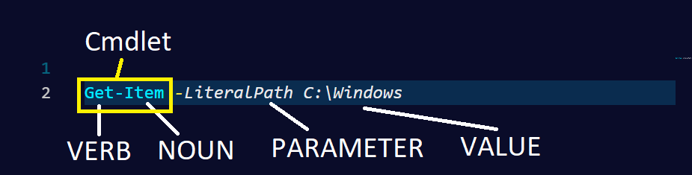
Notes:
Ask the students:
How would I change the value to look at the program files?

Slide 20
Aliases
Shorthand instance of the cmdlet
Use Get-Alias / Alias to get the list
Never for use in production code
Notes:
PowerShell Cmdlet Aliases are shortened instances of a cmdlet. They are used to improve the performance when you are working within the console. Alias don’t have a standard format defined.
You can use Get-Alias to return a list of Alias’s.
Never use Alias’s in production code. This is to aid in readability.
Some common alias
Gm – Get-Member
Dir\ ls \ Gci – Get-ChildItem.
Sources: https://docs.microsoft.com/en-us/powershell/developer/cmdlet/cmdlet-overview
Sources: https://docs.microsoft.com/en-us/powershell/developer/cmdlet/approved-verbs-for-windows-powershell-commands

Slide 21
Important Commands to know
Get-Command -> Gets All Commands
Get-Help -> Get’s the Help for a Command
Get-Member -> Get’s the Members, Properties, Methods of Objects
Notes:
https://docs.microsoft.com/en-us/powershell/module/microsoft.powershell.core/get-help?view=powershell-6
https://docs.microsoft.com/en-us/powershell/module/microsoft.powershell.core/get-command?view=powershell-6
https://docs.microsoft.com/en-us/powershell/module/microsoft.powershell.utility/get-member?view=powershell-6

Slide 22
Demo Time!
Notes:
In this demo we are going to:
Explore the Verb-Noun Format
Get-Process (Ask the class)
Get-ChildItem
Explore Get-Command and Get-Help
Get-Help -Name Get-Process
Get-Help -Name Get-ChildItem
Explore Parameters
Get-Help -Name Get-Process -Full
Get-Help –Name Get-ChildItem –Full
Get-Process –Name
Get-ChildItem –LiteralPath -File
Explore Alias
Use Get-Alias to get Get-Process

Slide 23
The PowerShell
“Pipeline” Explained
Notes:
The PowerShell Pipeline!

Slide 24
Pipelines
Act like connected segments of pipe
Using Pipeline Operator “|”
Reduce Effort
Passes Objects not Text
Notes:
The PowerShell Pipeline allows you to send the output (not text) from one command into the input for another command using the operator “|”.
This was implemented to reduce effort of using complex commands and make it easier to see the flow of commands.
What’s different between command prompt “|” operator? PowerShell Passes Object’s not just text.
For example:
Getting the Actual Object (Filename, Size, Length) vs Filename
https://docs.microsoft.com/en-us/powershell/scripting/learn/understanding-the-powershell-pipeline?view=powershell-6

Slide 25
New-TemporaryFile | Set-Content
Get-ADUser | Disable-ADUser
Get-ChildItem | Remove-Item

Slide 26
Demo Time!
Notes:
In this demo we are going to explore the PowerShell Pipeline:
Everyone can follow along with this:
# Create a Directory D:\DEMO
New-Item -Path "D:\DEMO" -ItemType Directory
# Get the Current Date and export it to Demo02.txt
Get-Date | Set-Content -LiteralPath "D:\DEMO\Demo02.txt“
# Using Get-Process let’s open Mspaint
* Ask for Volunteer
Start-Process -FilePath mspaint
Get-Process -Name mspaint
Get-Process -Name mspaint | Stop-Process

Slide 27
WRITING Basic
PowerShell Scripts

Slide 28
Things to Know
Script Extension: .PS1
Module Files: “.PSM1” or “.PSD1”
PowerShell Versions:
Versions: 1 & 2 – Don’t Use
Versions: 3 & 4 – Not Recommended
Versions: 5 & 5.1 – Recommended
Versions: 6 & 7 – Yes Please
Notes:
Things to know about the PowerShell Script Files:
PowerShell Script Files are denoted with the script extension .ps1
PowerShell Module Files are denoted with PSM1 and PSD1
PowerShell comes in many flavours:
Windows PowerShell:
Version 1 & 2. (Windows 7, Windows Server 2008 R2)
Version 3 & 4 (Windows 8, Windows Server 2012, Windows Server 2012 R2)
Version 5 & 5.1 (Windows 10, Windows Server 2016)
PowerShell Core:
Version 6 & 7 (Windows, Mac OS, Linux Operating Systems)

Slide 29
Do’s and Dont’s
Use the full Cmdlet name
Use the full Parameter Name
High Risk Cmdlets. Use –WhatIf
Document your Code!
Space your Code!
Don’t Run Code you Don’t Understand
Notes:
PowerShell Do’s and Dont’s
When writing Scripts: Use the full Cmdlet and Parameter Names
When using High Risk Cmdlets. If the cmdlet support’s it: Use the –WhatIf Parameter. Use AD
Document your Code! Documenting your code and your intentions is key for another person to understand.
Space your Code! Readability of code is really important.
Don’t run code you don’t understand. This year I had a person come up to me at a Microsoft conference and told me that people like me will be out of a job, because all he had to do was copy and paste code from the internet.
Every environment is different and you might be introducing a fatal bug in your code.

Slide 30
Script Execution Policy
Implemented to Protect against execution of unauthorized code
Configurable Through Group Policy or Can be set in Console
Set-ExecutionPolicy
Set to Restricted by Default
Notes:
Who remembers Windows 95/98?
Virus were rampart. Notable virus’s such as:
WIN95 CIH – (Chernobyl) At a programmed time, it would attempt to reflash the BIOS of the PC. (No backup systems then)
Melissa – Mass Mailing Macro Virus (Attached to Microsoft Word and Outlook)
ILOVEYOU – Log Bug was a computer worm. Written in VBScript
Microsoft then introduced Group Policy to combat this. This didn’t work. Group Policy is not secure at all.
Quick question: What is the most insecure command prompt command? NET.EXE / (Was whitelisted for mapping drive letters. But Net.exe can do a lot more)
Windows 7 – Microsoft Introduced AppLocker and PowerShell
AppLocker – Prevent Application Execution using (Digital Signature, ProductName, File Name, File Version)
PowerShell Execution Policy – Can prevent PowerShell Scripts from running that meet the criteria requirements:
These are:
AllSigned
Scripts can run.
Requires that all scripts and configuration files be signed by a trusted publisher, including scripts that you write on the local computer.
Prompts you before running scripts from publishers that you haven't yet classified as trusted or untrusted.
Risks running signed, but malicious, scripts.
Bypass
Nothing is blocked and there are no warnings or prompts.
This execution policy is designed for configurations in which a PowerShell script is built in to a larger application or for configurations in which PowerShell is the foundation for a program that has its own security model.
Default
Sets the default execution policy.
Restricted for Windows clients.
RemoteSigned for Windows servers.
RemoteSigned
The default execution policy for Windows server computers.
Scripts can run.
Requires a digital signature from a trusted publisher on scripts and configuration files that are downloaded from the internet which includes email and instant messaging programs.
Doesn't require digital signatures on scripts that are written on the local computer and not downloaded from the internet.
Runs scripts that are downloaded from the internet and not signed, if the scripts are unblocked, such as by using the Unblock-File cmdlet.
Risks running unsigned scripts from sources other than the internet and signed, but malicious, scripts.
Restricted
The default execution policy for Windows client computers.
Permits individual commands, but will not run scripts.
Prevents running of all script files, including formatting and configuration files (.ps1xml), module script files (.psm1), and PowerShell profiles (.ps1).
Undefined
There is no execution policy set in the current scope.
If the execution policy in all scopes is Undefined, the effective execution policy is Restricted, which is the default execution policy.
Unrestricted
The default execution policy for non-Windows computers and cannot be changed.
Unsigned scripts can run. There is a risk of running malicious scripts.
Warns the user before running scripts and configuration files that are downloaded from the internet.
Set-ExectionPolicy is used to change it.

Slide 31
Using the PowerShell ISE
A PowerShell Host
Graphical Editor
Add Syntax-Colouring, Tab Completion, IntelliSense, Visual Debugging & Help
Built for Scripting
Notes:
The PowerShell ISE is a PowerShell Host that is used for scripting and debugging.
It has Syntax Colouring, Tab Completion, Intelli Sense, Visual Debugging and Help!
It was designed to aid in writing and testing PowerShell scripts.

Slide 32
Demo Time!
Notes:
In this demo we are going to:
Explore the PowerShell ISE
Setting Script Execution
Create a PowerShell File .ps1
Let’s write a script:
Let’s Create a New Virtual Machine
All Students Write their Very First PowerShell Script (Optional)
Open PowerShell as administrator
Set-ExecutionPolicy -ExecutionPolicy Unrestricted
Write-Host “Hello World!”

Slide 33
AUTOMATING
with PowerShell
Notes:
The PowerShell Pipeline!

Slide 34
Understanding Control Flow
“Sequences”
Babies at 41 ½ to 46 ½ Weeks Learn Sequences
We Naturally Perform “If” “Then” Tasks
Control Flow is the Same
Notes:
People think that understanding code is difficult to understand and complicated.
However all programming code is simplified by “Sequences”.
Recently my baby has undergone her 7th Leap. A leap is a increase of mental development for the baby. In this instance the leap she has undergone is the leap of sequences.
Sequences is an important leap for the baby since they are understanding to achieve an outcome there needs to be a certain set steps. These steps cannot be completed out of order. For Example:
Outcome = Brush Teeth
Pick up toothbrush
Pick up toothpaste
Check if toothpaste is empty. If so, Go To Open New Toothpaste Routine
Open Cap
Squeeze on Toothbrush
Has enough toothpaste been squeezed? If not, repeat step 5.
Put down toothpaste
Put in mouth
Brush
Has Brush Time Completed? (4 Minutes) Repeat Step 9
Spit in Bowl
Is the Tap turned on? Turn on Tap.
Rinse Mouth
Completed
We naturally perform If \ Then \ Else \ Loop Statements. Let’s use an example:
Ask for volunteer :
*Demonstrate Process of putting blocks in holes. Naomi’s Toy
* Hand Square Block / * Hand Circle Block
Flow Control is exactly the same. We use the sequences of the application (PowerShell, SQL, C#, C++) to transform into an outcome.
Flow control is slow to learn, however it’s something that is learned. Each language has unique aspects, however once you have learned a single language stepping across is much easier.
REMEMBER: This is a perishable skill. You don’t use it, you will lose it!

Slide 35
Object Orientated Programming
A methodology of grouping Properties and Methods (Actions)
Objects contain data in the form of Properties / Fields
Methods contain executable code
Objects are Type Specific
Notes:
Object Orientated programming type that groups instructions together with the same part they operate on.
For example:
A car Object would have items pertaining to a car, not a hot air balloon.
Objects contain data in the form of:
Properties / Fields -> Storage of Data
And
Methods -> Storage of Executable Code.
In PowerShell we use Get-Member to show the list of properties and methods attached to an object.
Objects are Type Specific.
Examples: Using the Baby Toy. Is a triangle a square? Is a square a circle? Is a circle a star? Types are different.

Slide 36
Demo Time!
Notes:
Build a Domain Controller
Configuration a Domain Controller
Create some AD Users
Reset Passwords – Interactivity
Import-Module ActiveDirectory
# Let's Create a User
New-ADUser -Name "Test User1" -DisplayName "TestUser1"
# Get Someone to Create Test User 2
New-ADUser -Name "Test User2" -DisplayName "TestUser2"
#
# Challenge
# Get someone up to change the displayName from: Test User2 to MrT
Get-ADUser -Identity "Test User2" | Set-ADUser -DisplayName "MrT"
# Get Someone up to remove the user Test User2.
Get-ADUser -Identity "Test User2" | Remove-ADUser -WhatIf
# Confirm the change
Get-ADUser -Identity "Test User2" | Remove-ADUser

Slide 37
PowerShell 101
Discord Channel
https://discord.gg/ZF8fV9
Notes:
IT Recruitment:
Pablo Calaby
Senior ICT Consultant, Infrastructure
Level 17, Central Plaza II
66 Eagle Street
Brisbane, 4000 Australia
t: 07 3258 8327
m: 0402 456 588
pablo.calaby@hudson.com

Slide 38
Pablo Calaby
Hudson Recruitment
Level 17, Central Plaza II
66 Eagle Street
Brisbane, 4000 Australia
t: 07 3258 8327
pablo.calaby@hudson.com
Notes:
IT Recruitment:
Pablo Calaby
Senior ICT Consultant, Infrastructure
Level 17, Central Plaza II
66 Eagle Street
Brisbane, 4000 Australia
t: 07 3258 8327
m: 0402 456 588
pablo.calaby@hudson.com

Slide 39
Questions?

